Slide 1
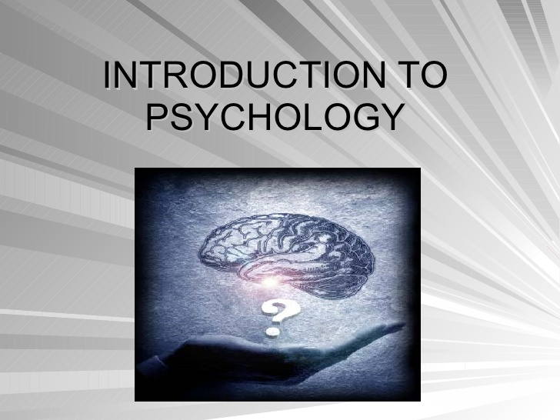

Slide 2
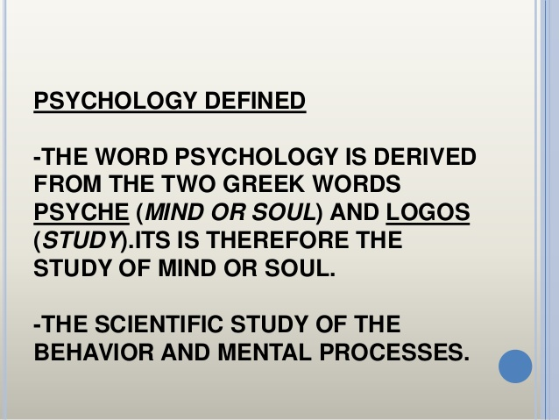

Slide 3
What is Behavior?

Slide 4
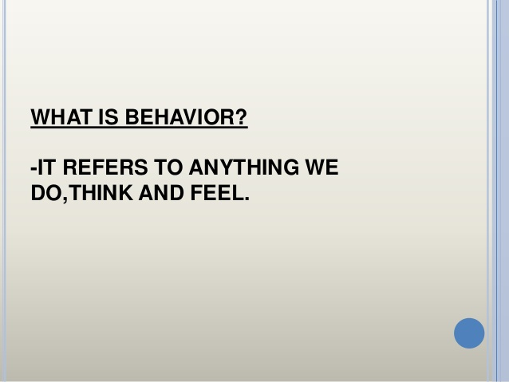

Slide 5
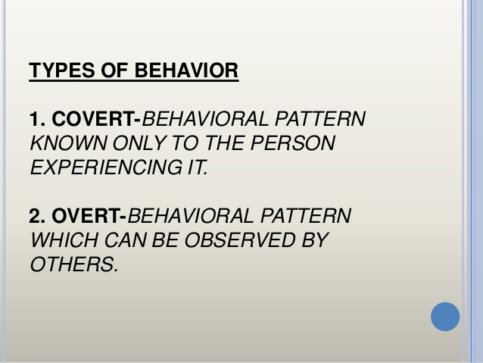

Slide 6
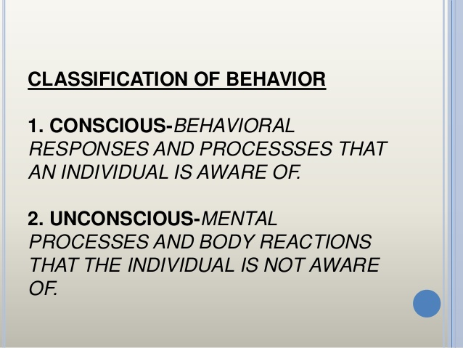

Slide 7
The Subfields of Psychology
Experimental psychology is the branch of psychology that studies the processes of sensing, perceiving, learning, and thinking about the world.
Cognitive psychology , which focuses on higher mental processes, including thinking, memory, reasoning, problem solving, judging,
decision making, and language.

Slide 8
Developmental psychology studies how people grow and change from the moment of conception through death.
Health psychology explores the relationship
between psychological factors and physical disease. For example, health psychologists are interested in assessing how long term stress (a psychological factor) can affect physical health and in identifying ways to promote behavior that brings about good health

Slide 9
Clinical psychology deals with the study, diagnosis, and treatment of psychological
disorders. Clinical psychologists are trained to diagnose and treat problems that range from the crises of everyday life

Slide 10
Counseling psychology focuses primarily on educational, social, and career adjustment problems. Almost every college has a center staffed with counseling psychologists. This is where students can get advice on the kinds of jobs they might be best suited for, on methods of studying effectively, and on strategies for resolving everyday difficulties, such as problems with roommates.
Many large business organizations also employ counseling psychologists to help employees with work related problems.

Slide 11
Our complex networks of social interrelationships are the focus for many subfields of psychology. For example, social psychology is the study of how people’s thoughts, feelings, and actions are affected by others. Social psychologists concentrate on such
diverse topics as human aggression, liking and loving
Cross-cultural psychology investigates the similarities and differences in psychological functioning in and across various cultures and ethnic groups. For example,
cross-cultural psychologists examine how cultures differ in their use of punishment during child rearing.

Slide 12
Working at Psychology
psychologists are employed in a variety of settings. Many doctoral-level psychologists are employed by institutions of higher learning (universities and colleges) or are self-employed, usually working as private practitioners treating clients. Other work sites include hospitals, clinics,
Mental health centers, counseling centers, government human-services organizations, businesses,
schools, and even prisons. Psychologists are employed in the military, working with soldiers

Slide 13
Most psychologists, though, work in academic settings, allowing them to combine the three major roles played by psychologists in society: teacher, scientist, and clinical practitioner. Many psychology professors are also actively involved in research or in serving clients. Whatever the particular job site, however, psychologists share a commitment to improving individual lives as well as society in general.

Slide 14
The Roots of Psychology
John Locke believed that children were born into the world with minds like “blank slates” ( tabula rasa in Latin)
formal beginning of psychology as a scientific discipline in Leipzig, Germany, Wilhelm Wundt established the first experimental laboratory

Slide 15
When Wundt set up his laboratory in 1879, his aim was to study the building blocks of the mind. He considered psychology to be the study of conscious experience.
His perspective, which came to be known as structuralism , focused on uncovering
the fundamental mental components of perception, consciousness, thinking,
emotions, and other kinds of mental states and activities.

Slide 16
functionalism An early approach to psychology that concentrated on what the mind does—the functions of mental activity and the role of behavior in allowing people to adapt to their environments.

Slide 17
Gestalt Psychology
A school of thought that perceives a whole psychological system as more significant than its single parts and that you cannot simply focus on a part in its simplest form.

Slide 18
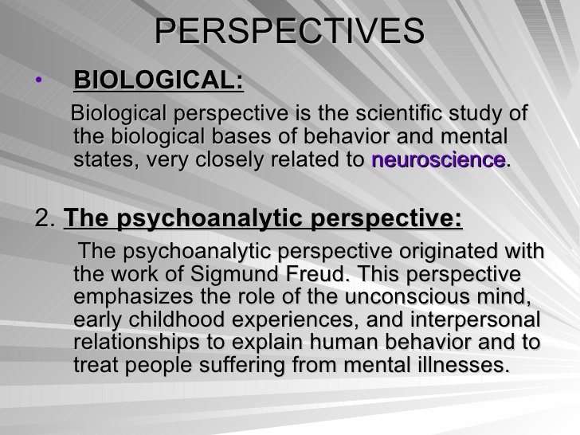

Slide 19
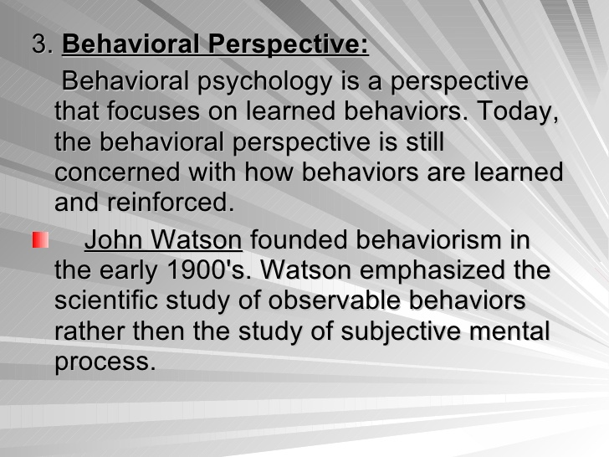

Slide 20
Humanistic Perspective
Humanistic approach psychology posits that everyone is unique and has their perspective towards the world. It believes that humans are good at heart and capable of making the right choices.

Slide 21
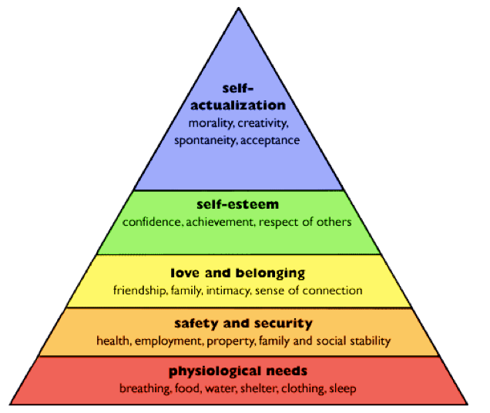
Maslow's Hierarchy of Needs

Slide 22
Cognitive Perspective
During the 1960s new perspective known as cognitive Psychology began to take hold. This area of psychology focuses on mental processes such as memory, Thinking, problem solving and decision making.

